Slide 1





King County House Sales
Team : Vishwajeet patil
(vishwajeetpatil2305@gmail.com) Guide: Aditya Dhambale
Disclaimer: The content is curated for educational purposes only.
Notes:
Slides: Prepare a short slide deck (10-12 slides) summarizing the project objectives, methodology, and key results.

Slide 2
OUTLINE
Abstract of the Project
Problem Statement
Proposed Solution
System Architecture
Conclusion
Future Scope

Slide 3
Abstract:
This dataset comprises house sales records, including transaction details such as sale prices, document dates, and property types. The primary objective of analyzing this dataset is to identify trends in real estate pricing, understand the distribution of sale prices, and assess market fluctuations over time. Key preprocessing steps include converting date fields to a standard format, ensuring numerical consistency in sale prices, and filtering out non-relevant attributes for analysis. Visualizations such as histograms and time series plots of median sale prices help reveal insights into market behavior. The findings from this dataset can assist in real estate market predictions and investment decision-making.

Slide 4
Problem Statement: Identify Trends – Examine historical sale prices to detect patterns and fluctuations over time. Understand Price Distribution – Analyze the distribution of house prices to determine common price ranges. Evaluate Market Behavior – Assess seasonal or long-term trends that affect property values. Data Cleaning & Processing – Ensure numerical consistency, handle missing

Slide 5
Proposed Solution:
1. Data Collection & Preprocessing
Load the house sales dataset and inspect its structure.
Handle missing values, duplicates, and inconsistencies.
Convert dates to a standardized format for time-based analysis.
Ensure numerical columns (e.g., sale price) are in the correct datatype.
2. Data Analysis & Visualization
Sale Price Trends: Group data by time periods (monthly/yearly) and analyze median sale prices.
Property Type Analysis: Categorize properties and compare pricing variations.
Geospatial Analysis (if location data is available): Identify price variations across different regions.
Price Distribution: Use histograms and box plots to visualize pricing spread.

Slide 6
System Architecture:
1. Data Ingestion Layer
2. Data Preprocessing Layer
3. Data Analysis & Processing Layer
4. Visualization & Reporting Layer
5. Optional Predictive Analytics Layer

Slide 7
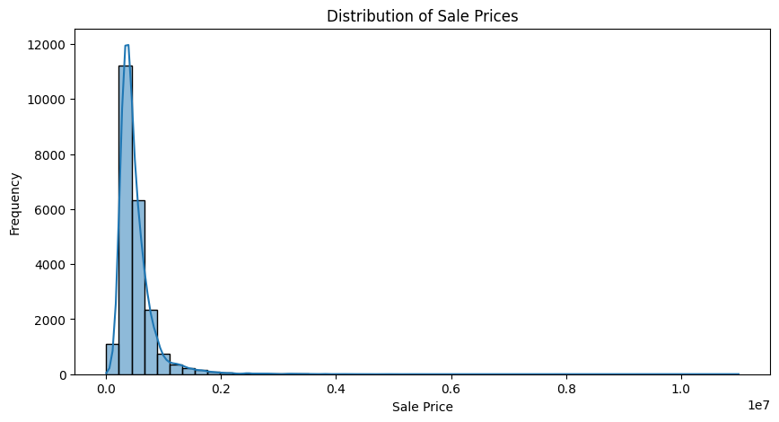
Live Demo of Project
The histogram shows a right-skewed distribution of house sale prices, with most homes sold at lower prices and fewer high-priced properties. The peak frequency is in the lower price range, while a long tail indicates rare, expensive houses. Outliers likely exist in the higher price range. 🚀

Slide 8
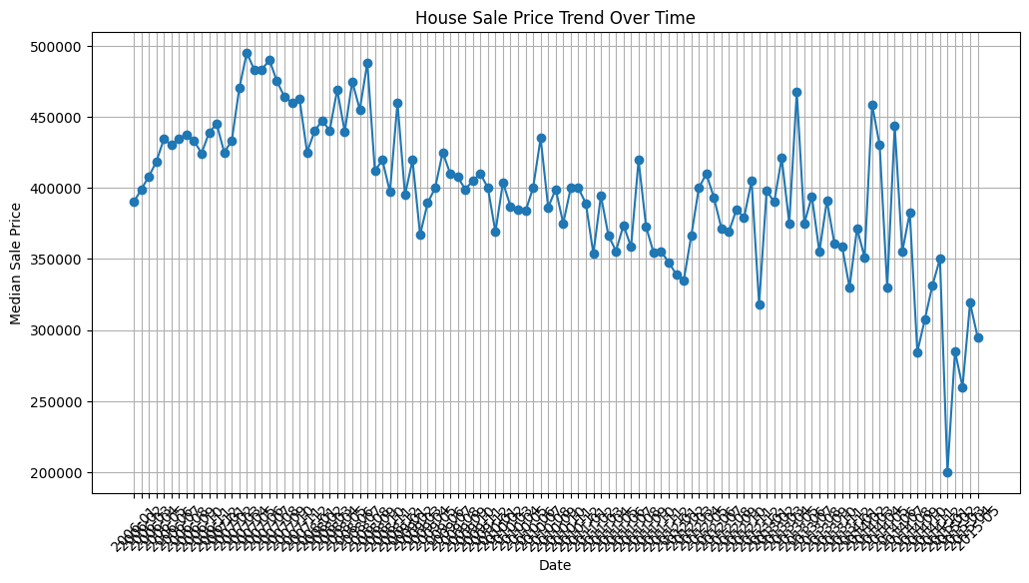
Live Demo of Project
The graph shows the trend of median house sale prices over time 📈. Initially, prices increase, peaking at around $500,000, followed by fluctuations and a gradual decline. The sharp variations indicate market volatility. The recent downward trend suggests a possible market correction or external influencing factors. 📉

Slide 9
Conclusion
The analysis of house sales data reveals significant trends in pricing over time. The distribution of sale prices shows a right-skewed distribution, indicating that most houses are sold at lower prices, while a few high-value properties drive the upper end of the spectrum. The time series trend suggests periodic fluctuations, with an initial rise in prices followed by volatility and a declining trend in recent times.
These insights can help buyers, sellers, and investors make informed decisions by understanding market trends, identifying optimal buying/selling periods, and assessing potential risks. Future studies can incorporate additional factors like economic conditions, interest rates, and demand-supply dynamics for deeper analysis.

Slide 10
Future Scope:
Enhanced Predictive Modeling
Geospatial Analysis
Real-Time Price Forecasting
Feature Expansion
Automated Decision Support System
Market Sentiment Analysis
Integration with Augmented Reality (AR) & Virtual Reality (VR)

Slide 11
Thank you!
Notes:
thank you very much for joining this PPT, keep learning.
11

